Slide 1


Tutorial: ISS multiple removal
Arthur B. Weglein
M-OSRP 2012 Annual Meeting, May 1, 2013
Notes:
1
1

Slide 2
Seismic E&P challenges
Methods make assumptions; when they are satisfied the methods are effective and when they are not satisfied the methods have difficulty and/or fail – challenges arise from that breakdown or failure.

Slide 3
Seismic E&P challenges
Among assumptions:
acquisition
compute power
innate algorithmic
assumptions/requirements

Slide 4
Innate algorithmic assumptions
Many processing methods require subsurface information
In complex and ill-defined areas that requirement can be difficult or impossible to satisfy
The inability to satisfy that requirement can lead to algorithmic failure and dry hole drilling

Slide 5
Innate algorithmic assumptions
The inverse scattering series states that all processing objectives can be achieved directly and without any subsurface information
Among processing objectives
  1. Free surface multiple removal
  2. Internal multiple removal
  3. Depth imaging
  4. Non-linear AVO
  5. Q compensation
All without subsurface information.

Slide 6

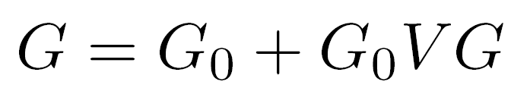

Inverse Scattering Series
Scattering theory = perturbation theory
(1)
Eq.(1) can be expanded in a forward scattering series,

Slide 7
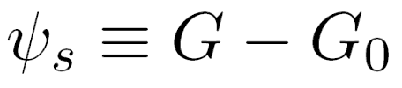



The scattered field can be defined as
(2)
Where is the portion of that is order in .
D, where
The measured values of are the data

Slide 8



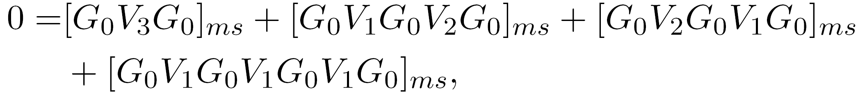
The inverse relation to (2), expands
(3)
as powers (orders) in the measured values of Ψs.
Substituting (3) into (2) and evaluating (2) on the
measurement surface results in
( )m
……

Slide 9
Therefore, the ISS is not only the only direct inversion method for a multidimensional acoustic, elastic, anelastic earth, but it further communicates that all inversion tasks/processing goals are able to be achieved directly and without subsurface information.
Direct and without subsurface information are two distinct and independent properties.

Slide 10
The combination represents a powerful and unique capability and unconventional thinking with stand-alone potential for addressing challenges that are caused by methods that are either indirect (and are necessary conditions, but not sufficient – and therefore are not equivalent to direct methods) and/or are dependent on a-priori information or other assumptions that cannot be adequately provided. The latter is especially significant as our exploration portfolios increasingly move to complex marine and on-shore plays.

Slide 11
That unique promise and potential is what the ISS, combined with the concept of isolated task subseries, offers.

Slide 12
Non-linearity (2 types)
Innate or intrinsic non-linearity
e.g., R.C. and material property changes.
Circumstantial non-linearity
- Removing multiples or depth imaging
primaries.

Slide 13
The inverse scattering series is (once again) unique
in its ability to directly address either alone, let
alone these two in combination.

Slide 14
The first term in a task specific subseries that addresses a potential circumstantial non-linearity first decides if its assistance and contribution is required in your data…
And only if decides that it is, then it starts to compute … if there is no nonlinear circumstantial issue to address, it computes an integrand which is zero.

Slide 15
The latter is a very sophisticated and impressive (and surprising) quality of task specific subseries
We call that property purposeful perturbation theory….
It decides if its assistance is needed before it acts!

Slide 16
Free-surface multiple removal
16
Notes:
16

Slide 17

The 1D FS multiple removal algorithm
Data without a free surface
1
Data with a free surface
contains
free-surface multiples.
1

Slide 18
Free surface demultiple algorithm
= primaries and
internal multiples
= primaries, free
surface multiples
and internal
multiples
1
Total upfield
and,

Slide 19
Free surface demultiple example
t₁
t₂
t₁ + t₂
2t₁
2t₂

Slide 20
t₁ + t₂
2t₁
2t₂
So precisely eliminates all free surface
multiples that have experienced one downward
reflection at the free surface.
The absence of low frequency (and in fact all other
frequency) plays absolutely no role in this prediction.

Slide 21
Free Surface Multiple Elimination Example Recovering an Invisible Primary
Consider a free surface example with the following data:
(1)
R₁δ(t-t₁) -R₁²δ(t-2t₁) R₂'δ(t-t₂)
FS
t₁
2t₁
t₂
R₁
R₂
Notes:
21

Slide 22
Invisible primary example
Now assume
for some special case, then from (1)
(2)
The second primary and the free surface multiple cancel, and
Notes:
22

Slide 23
Invisible primary example
and you have the two primaries, recovering the invisible primary which was not ‘seen’ in the original data.
How does that happen?
Notes:
23

Slide 24
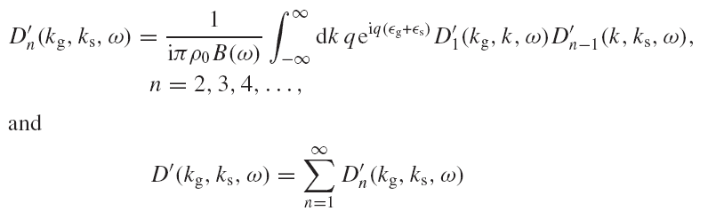
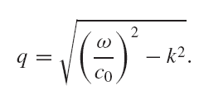
2D free surface multiple algorithm
The obliquity factor is defined as,

Slide 25
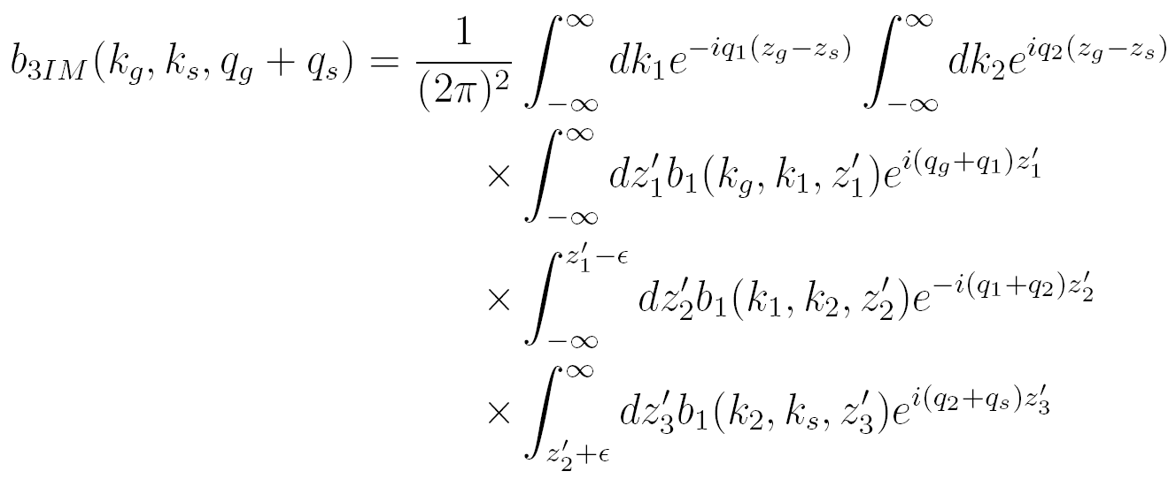
2D internal multiple attenuation algorithm
(Araujo 1994; Weglein et al. 1997)

Slide 26

Internal Multiple Removal in Offshore Brazil Seismic Data Using the Inverse Scattering Series
Master Thesis
Andre S. Ferreira
Advisor: Dr. Arthur B. Weglein
November 15, 2011

Slide 27
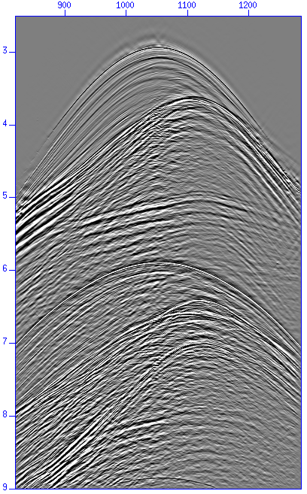
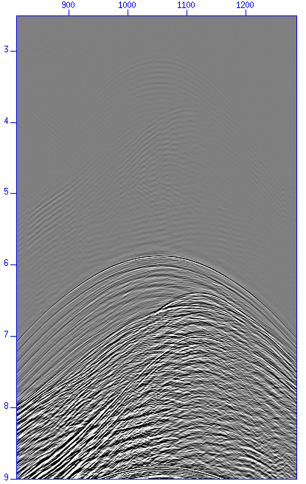
Multiple attenuation
Free surface multiple attenuation
  Multiple prediction
Shot gather
Corresponding multiple
prediction
Notes:
27

Slide 28
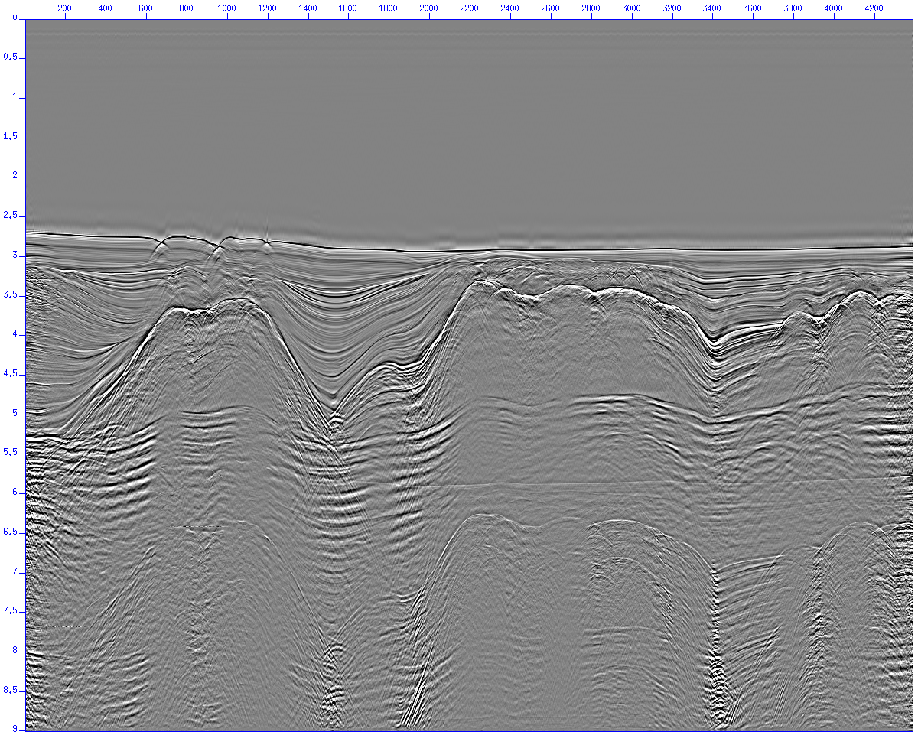
Multiple attenuation
Free surface multiple attenuation
  Stack before free surface multiple removal
Notes:
28

Slide 29
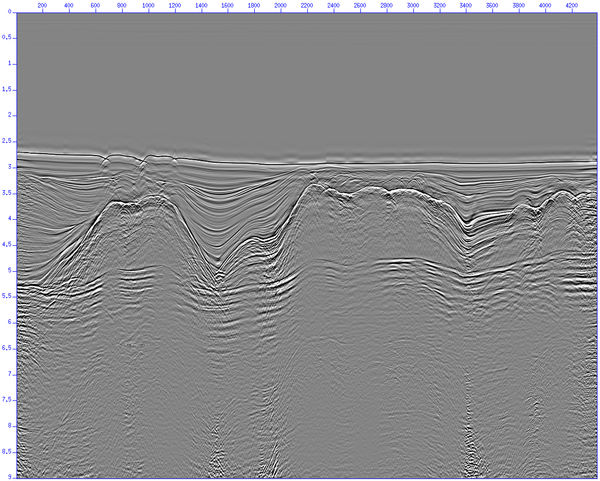
Multiple attenuation
Free surface multiple attenuation
  Stack after free surface multiple removal
Notes:
29

Slide 30
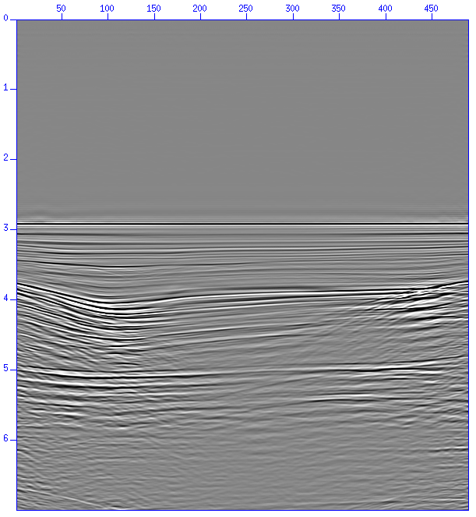
Multiple attenuation
Internal multiple attenuation
  The internal multiple high computer cost process
Notes:
30

Slide 31
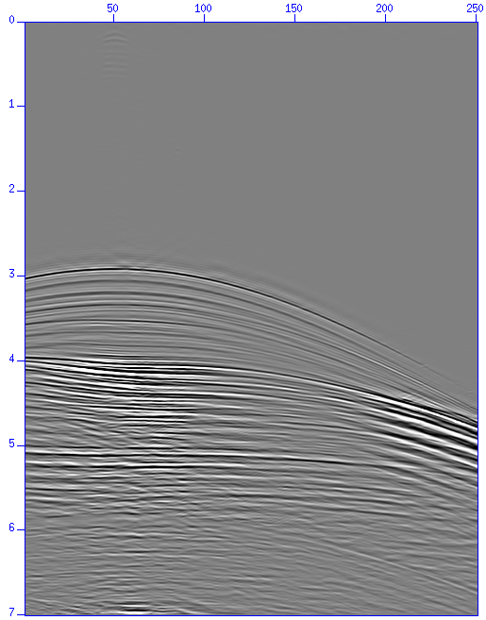
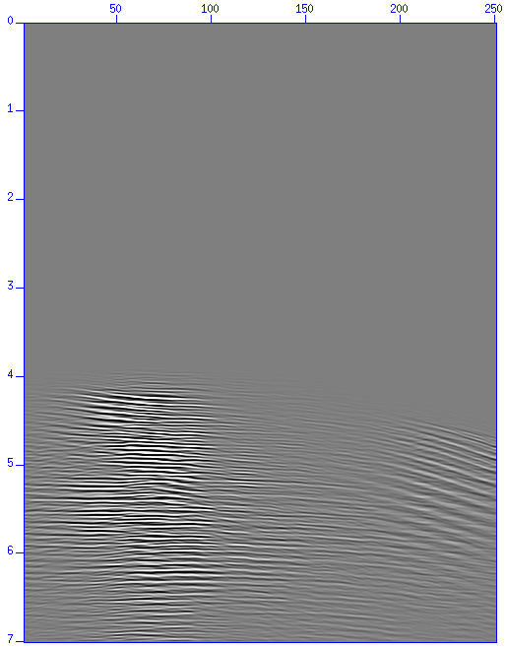
Multiple attenuation
Internal multiple attenuation
  Multiple prediction
Shot gather
Corresponding multiple
prediction
Notes:
31

Slide 32
Multiple attenuation
Internal multiple attenuation results
  Stacked section used to test the internal multiple code

Slide 33
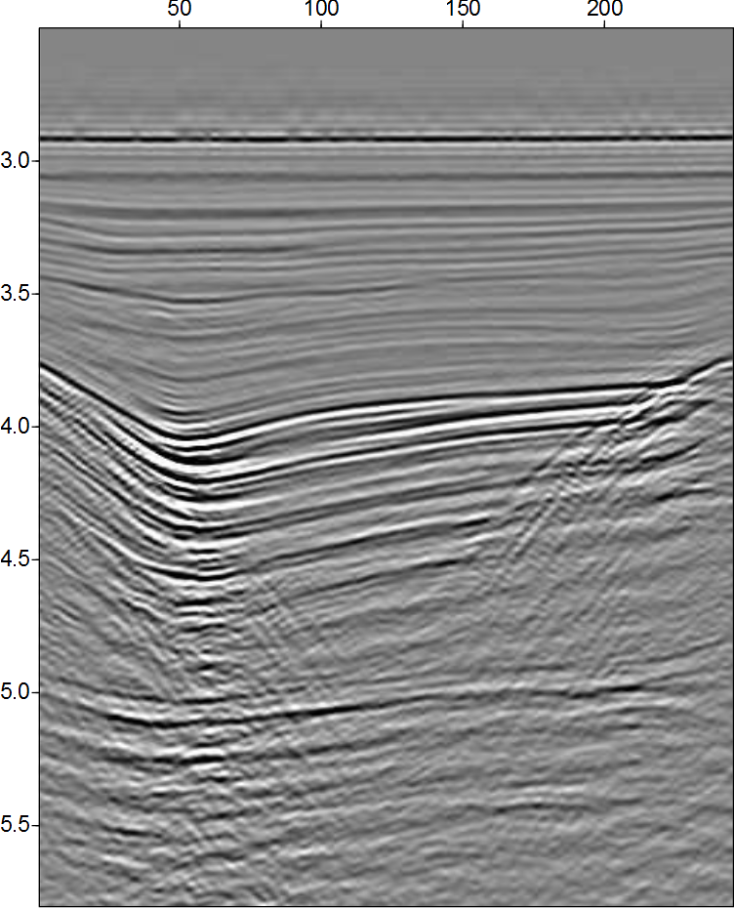
Multiple attenuation
Internal multiple attenuation results
  Common offset sections

Slide 34

Multiple attenuation
Internal multiple attenuation results
  Common offset sections

Slide 35
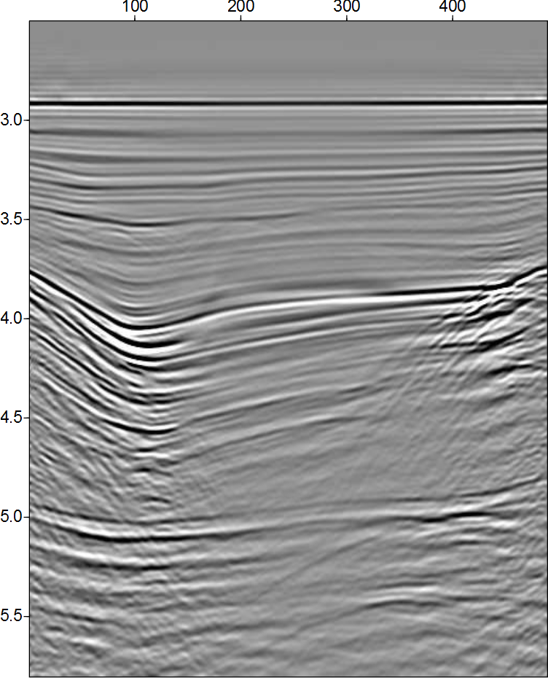
Multiple attenuation
Internal multiple attenuation results
  Stacked sections

Slide 36
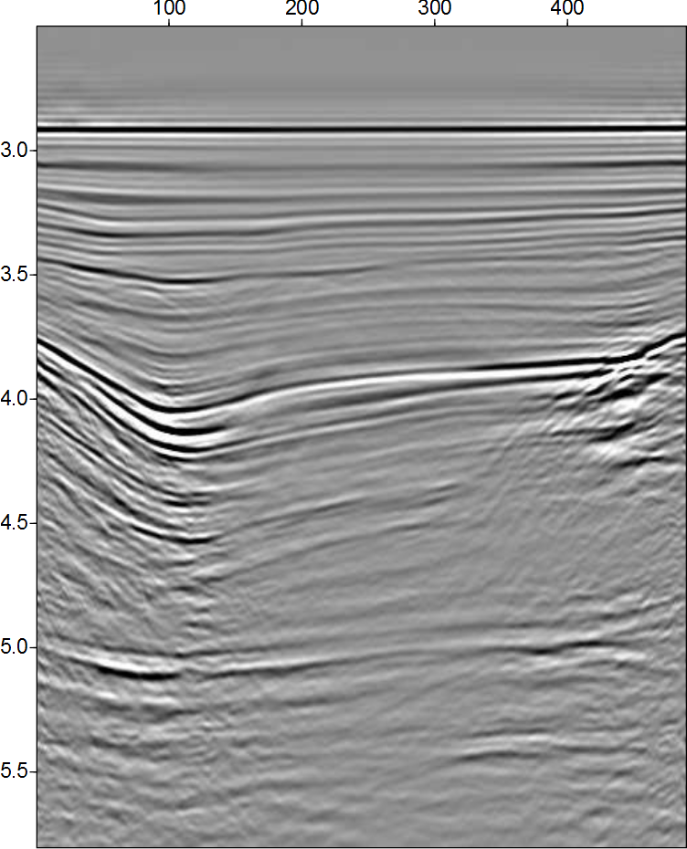
Multiple attenuation
Internal multiple attenuation results
  Stacked sections

Slide 37
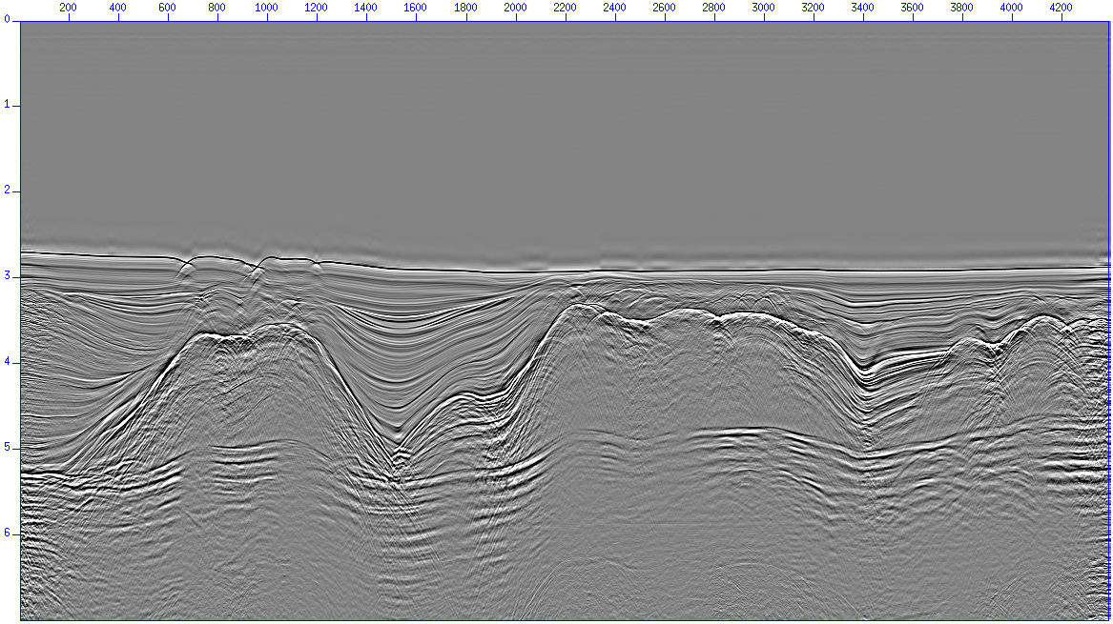
Multiple attenuation
Internal multiple attenuation results (stacked sections)

Slide 38
Multiple attenuation
Internal multiple attenuation results (stacked sections)

Slide 39

Multiple attenuation
Internal multiple attenuation results (stacked sections)

Slide 40
Conclusions
Multiple removal/attenuation is a major problem in seismic exploration
Free surface multiple removal results
  Multiple prediction is excellent
    Improved when source wavelet information was provided
  Anti-alias filter application is important
  Multiples from 3D structures are attenuated but not removed
  Adaptive subtraction required
Internal multiple attenuation results
  Multiple prediction is excellent
  Very high computer cost (both CPU time and memory)
  Adaptive subtraction required

Slide 41
Conclusions
ISS methods were able to attenuate both free surface and internal multiples in a very complex situation
  No a priori information about the dataset is necessary
  No other tested method was able to attenuate the sequence of internal multiples below the salt layers
  High computer cost (internal multiples)
  Adaptive subtraction requirement

Slide 42
Land application of ISS internal multiple
“Their (ISS internal multiple algorithm) performance was demonstrated with complex synthetic and challenging land field datasets with encouraging results, where other internal multiple suppression methods were unable to demonstrate similar effectiveness.”
- Yi Luo, Panos G. Kelamis, Qiang Fu, Shoudong Huo, and Ghada Sindi, Saudi Aramco; Shih-Ying Hsu and Arthur B. Weglein, U. of Houston, “The inverse scattering series approach toward the elimination of land internal multiples.” Aug 2011, TLE

Slide 43


